Slide 1
Data Governance at Progressive
Managing Data as an Asset
Analyst Bootcamp – April, 2024
Karen Jensen Mgr – Data Governance

Slide 2
Why is Data Important at Progressive?
What is Data Governance?
What are the benefits of Data Governance
DG Organizational Structure
DG Framework
DG Capabilities

Slide 3
as·set
/ˈaset/
noun
a useful or valuable thing, person, or quality. "quick reflexes were his chief asset"
Similar: strength, advantage, benefit, strong point, forte, talent, strong suit, blessing
Attractive feature: selling point, resource, value
Opposite: liability, impediment, hindrance
Notes:
We don’t manufacture things – the service we provide is to provide insurance to our customers at the most competitive yet profitable price possible by leveraging all the data points we have to analyze risk, probabilities, trends etc.
Data is the raw material of insurance – and therefore an asset
Key competitive advantage

Slide 4

At Progressive, we have “Reverence for Data”
We are a data driven organization and use data to power segmentation, customer experience and our decision making
1
Better products and services lead to our growth and scale which brings more data
5
We gather internal and external data and make it accessible
#FreeTheData
2
4
Insights lead to more products and better services
3
We have a talented analytical community and leaders who ask insightful questions of the data

Slide 5
Treat Data as an Asset
To gain full value of our data, Progressive must ensure that it is understood, tracked, optimized and controlled. As we move through transformation efforts, we should:
Understand our data ecosystem, including where the data resides and how it is transformed and leveraged.
Understand the relative value of data within the data pipeline and eliminate data sources that are not needed for business purposes.
Know what data is being acquired from outside vendors and how it is being used internally.
Don’t buy, keep or ask for more data than the organization needs.
Eliminate irrelevant, erroneous and duplicative data from the environment, depending on how controlled its environment is.
Create a golden source of data across the data ecosystem to ensure accuracy and consistency.
Notes:
A key to broadening the audience that gets value out of our data is ensuring that it is understood, tracked, optimized and controlled
What are the primary data sources for each business unit for operations and analytics?
What data is the most impactful and/or critical
Where do we have duplicates of data? Of those versions, which has the best quality?
Do we understand our problem areas?? Missing Data, truncated data, erroneous data and unavailable data?
Do we have a consistent language to talk about our data across business lines and with newly acquired organizations?
If we were a manufacturer, rather than an insurance carrier, the raw materials for each our products would be tracked, managed and quality checked; these raw materials are assets that have a cost for acquiring, storing, moving and quality monitoring – data is our raw material and a key piece to the delivery of our products!

Slide 6
What is Data Governance?
Simply said….
Data governance is everything you do to ensure data is secure, private, accurate, consistent, available, and usable.
It includes the actions people must take, the processes they must follow, and the technology that supports them throughout the data life cycle.

Slide 7


We need to treat and manage data as our core asset
Asset: something which generates value + something we protect
DATA OFFENSE
DATA DEFENSE
Enable business to make data-driven decisions & improve competitive position, growth & profitability​
Delivers quality, curated data to the business
Minimize data risks, maintain data integrity & ensure compliance with regulations​
CORE DATA GOVERNANCE - FOCAL AREAS
Establish ownership
Define & provide context
Build trust
Establish guidelines & enforce standards
Make it discoverable
Make it accessible
Protect sensitive data
Evangelize importance
Notes:
We apply both offensive and defensive tactics to govern our data – a blended strategy
Embrace offensive tactics – these tactics drive data insights and improvements in our data processes
Use data as competitive asset - A blended strategy puts community building and business experts at the forefront so they can demonstrate how to use data as a competitive asset. These data evangelists focus on improving the organization’s effectiveness, optimizing operations, and driving business outcomes — all by using data intelligently
Data Intelligence and Governance (DIG) - combines data visibility with data control. This wider perspective enlightens data users by consolidating the offensive information around what data is available and where the data comes from, while also enabling defensive guardrails to be placed easily around the data for control and governance.
The focus of governance changes from locking the data away to enforcing accountability while guiding people toward trusted data and the appropriate, compliant behaviors for using it.
Many of the tasks associated with Data Governance aren’t “new” to projects – typical DG frameworks reinforce the necessity to complete these tasks as evidence of managing data like an asset

Slide 8
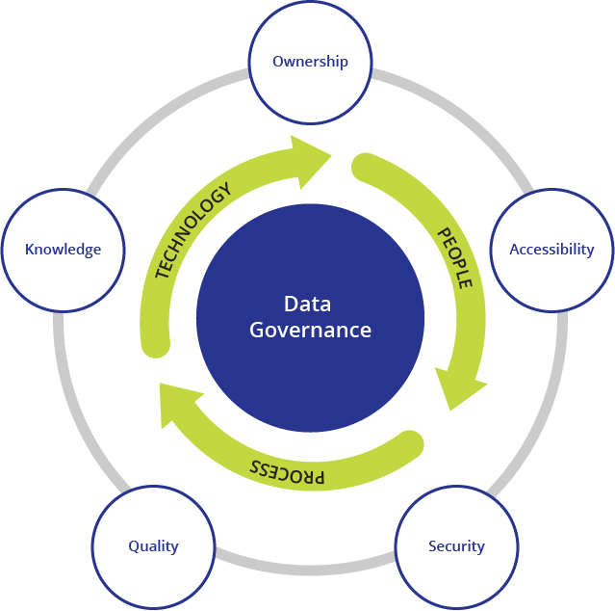
4 Key Benefits of Data Governance
Enables true data democratization
Everyone has a right to data that will help them make better decisions. Data governance ensures that you can uphold that right, without compromising on data security.
Builds effective collaboration between teams
Processes that ensure data is publicly discoverable, commonly understood, documented and easily accessible enable data users to leverage data and reduce friction between diverse data practitioners.
Protects the integrity and relevance of data
For data to be the bedrock of impactful decisions it must be relevant, accurate, trustworthy, easy to use, and have high quality.
Helps comply with data protection laws and regulations
Good data governance tools and processes ensure automated compliance with data protection laws and regulations
Fundamentally, data governance ensures effective collaboration and data democratization.
Notes:
Enables true data democratization
With the right modern data governance platforms, you can create granular and customized tag-based access policies. Examples of tags include business-related metadata, technical metadata, or even security classifications. Such a system also ensures being transparent about how decisions are taken regarding which team member has access to certain data and who doesn’t.
Builds effective collaboration between teams
Having a clear understanding of who should have access to data and who shouldn't, also reduces the friction between diverse data practitioners existing in the same or different teams. For e.g. A person looking at a restricted data asset knows who owns it, and can quickly request access with the click of a button. Also, if a particular data is publicly discoverable, no matter if it's in a different domain, a data user doesn't need to wait for days for IT to give them access to that data or for domain experts to relay what that data actually means.
Protects the integrity and relevance of data
Data governance ensures that by employing the following:
Tracking and managing of all data in an organization with help of data catalogs.
Creating business glossaries for ease of understanding of this data.
Setting up data lineage to enable root-cause analysis and impact analysis.
Management of data access via established and communicated policies.
Helps comply with data protection laws and regulations
Last but not the least, the reason why most organizations start thinking about data governance - is to comply with data protection laws and regulations. Even a minor infringement of GDPR or CCPA regulations can cost an organization a fortune. Good data governance tools and processes ensure automated compliance with such regulations and laws. They create universal guidance for the structured creation, storage, and deletion of data.

Slide 9
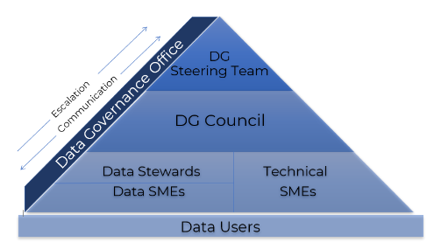
DG Organizational Structure
CENTRALIZED
(DGAP “pillar” within DATE/EDS)
FEDERATED
(across biz units)
Data Governance Office (DGO)
Data Architecture
Data Privacy Office (DPO)
Aligned DG Roles by Domain
Aligned Data Architects by Domain
Notes:
While the DGO and DPO drive what must be done from a governance and privacy perspective, it is the business units and their respective DG practitioners that fund and execute against these efforts.
DGO/DPO align standards, guidelines and controls to compliance laws and best practices
The DGAP team provides capabilities to enable governance and

Slide 10
DG Community Roles
DataGov/
Roles a Data Analyst might fulfill
DG Steering | DG Council (DGC) | DG Steward | Data Subject Matter Expert (SME) | Technical Subject Matter Expert (T-SME)
Senior Leaders across all lines of business – responsible to drive strategic direction for DG​ | Leads data governance initiatives aligning efforts to business objectives | Ensure the usage and creation of data is aligned to the needs of the business | ​Tactical execution of DG efforts set forth by DG Steering & DG Council | Ensures technologies produce data in alignment with data governance framework, mitigating data debt & issues
Strategize Champion Influence | Lead Define Promote | Represent Discover Define | Evaluate Deliver Map | Store Process Manage
Understand, promote and support the Enterprise Data Governance Vision, Tactics and Priorities Meet frequently with your DG Council member, to drive DG initiatives in support of business objectives and understand impact and effort to perform these duties Plan for and ensure adequate staffing of various DG roles to support treating data as an asset | Lead the data stewardship organization in assigned business line, including identifying, onboarding and coaching data stewards and SMEs Understand and promote the Enterprise Data Governance Vision, Tactics and Priorities Participate in defining, building and implementing enterprise standards, processes, and policies to govern Progressive's data Meet frequently with your Stewards, to facilitate DG efforts and escalate data issues/feedback to DG Steering or DGO Facilitate discussions and engage on data-related projects, representing assets and DG requirements within your business unit Coordinate data stewards' assignments and manage their allocations on projects and other DG activities Establish and monitor key DG metrics for data quality and DG compliance | Represent your data domain and lead, participate and influence data-related decisions for your area Understand and promote the Enterprise Data Governance Vision, Tactics and Priorities Work with DG Council Members to build and implement enterprise standards, processes, and policies that govern Progressive data Meet frequently with your SMEs to move the DG agenda forward and escalate any issues/feedback to DG Council, DG Steering or DGO Engage on data-related projects and facilitate the gathering of DG requirements Ensure the integrity of the data assets you represent, making sure well-documented, timely updates are made in DIG Champion for improved data quality through the identification, documentation, and resolution of data issues | In collaboration with data architects and stewards, use the Data and Information Governance Tool (DIG) to document information on data Address questions and inquiries about your assets, communicate any known issues to the users and work with stakeholders to resolve issues Engage on data-related projects, gather requirements pertaining to data governance and represent the DG project requirements Meet frequently with your Data Steward and escalate any issues/feedback to DG Council, DG Steering or DGO Ensure the integrity of the data assets you represent and make sure they are well-documented and updated in a timely manner Champion for improved data quality through the identification, documentation, and resolution of data issues in your business unit | Responsible for the operation and management of technology and systems that collect, store, process, manage, and provide access to Progressive data Understand and promote the Enterprise Data Governance Vision, Tactics and Priorities from a technology perspective Meet frequently with your Data Stewards and/or SMEs to align technology efforts with DG requirements. Participate in on-going education and training regarding the technical aspects of DG standards and requirements On data-related projects, facilitate the completion of DG requirements by technology team members Collaborate with DG Council, Data Stewards and SMEs to understand and prioritize technology issues to resolve data issues

Slide 11
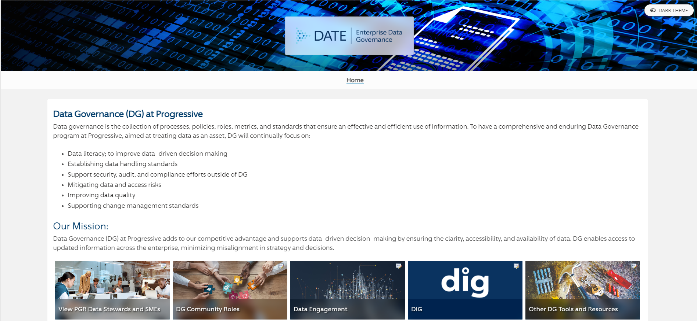

Data Governance Site - DataGov/
Who are the Stewards/ SME’s?

Slide 12
Data Governance Framework – DataEngagement/
 | Data Engagement Base Requirements Matrix |  |  |  | Support Type & DBMS | IT Supported & Snowflake | IT & Non-IT Supported & All other non-Snowflake DBMS
 | ID | Data Engagement Requirement | Accountable Role | Responsible Role
 | 1 | Data Governance Accountability | Data Steward | Data SME |  | x | x
 | 2 | Identification of CHS and Restricted Data (Data Discovery) and Sensitive Data Classification | Data Steward | Data SME |  | x | x
 | 3 | Identify Security Owners and Provision Entitlements | Data Steward | Technical SME |  | x | x
 | 4 | Free the Data | Data Steward | Data SME |  | x
 | 5 | Find the Data | Data Steward | Data SME |  | x
 | 6 | Business Documentation of Critical Data | Data Steward | Data SME |  | x | x
 | 7 | Data Sanitization in Non-Production Environment | Data SME | Technical SME |  | x
 | 8 | Physical Naming Standards | Data Architect | Technical SME |  | x | x
 | 9 | Data Flow Diagram | Data Architect | Technical SME |  | x
Database Type/ DBMS |  | The Datatbase type / Database Management System (DBMS) platform where data will land or reside; the target. For example, Snowflake, DB2, Oracle, Mongo DB, etc.
Support Type |  | IT Supported - The work effort is supported by an IT group or team Non-IT Supported - The work effort is supported by business or data science.
Why do we need it?
Assurance that data is not an afterthought in projects
Data stakeholder participation
Assist in defining and fulfilling data needs of a project
Beyond projects….
DE Requirements illustrate the activities of data governance
Applicable beyond a project
The things we do to govern our data
Notes:
Base requirements ensure these fundamental data governance activities occur as part of a project
- DG stakeholders identified to participate, Sensitive data is identified and protected, appropriate approvers of entitlements are identified for new data, Data is made accessible to the primary roles who need to leverage it and it is documented to ensure appropriate and consistent usage and understanding, as well as some other technical requirements.
Beyond projects, however, data governance activities include other things such as data quality monitoring, retention, and

Slide 13
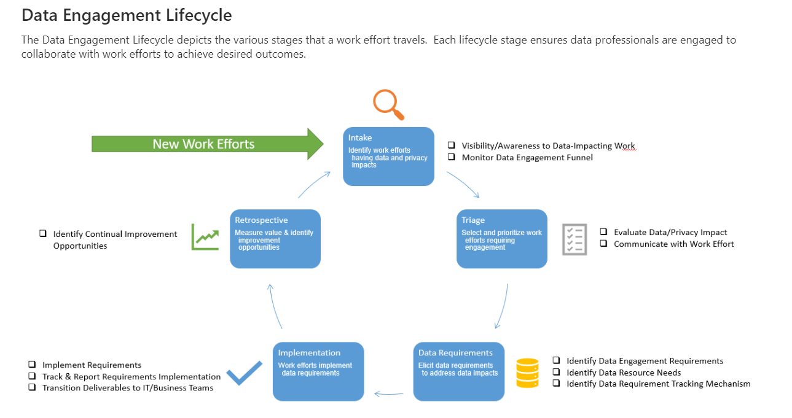
Data Engagement Lifecycle – Integrated in Project Methodologies
Notes:
Data engagement activities should be aligned with and interwoven with SDLC and agile development methodologies.
In many cases, they simply identify work that is already occurring, ensuring it is not overlooked.

Slide 14

Data Governance Capabilities and Processes
DIG
Governed Data Catalog
(Business & Technical Metadata)
Certified Metrics & Business Logic
Data Lineage & Reference Data Management
Business Glossary
Inventoried Data
Data Quality
Data Policies
Enterprise data catalog platform which allows users to discover, explore and gain access to trustworthy data http://dig/
FindTheData/ – Tableau List of security entitlements for various data stores throughout PRG
FreeTheData/ – The Free the Data program helps our analyst community to seamlessly gain access to qualifying data.
Notes:
DIG is the central collaboration point for Data Governance. It is a home-grown application, that is continuing to expand.
Its initial focus was to capture data dictionaries, which provide the technical metadata for our databases; this was captured on an ad-hoc basis.
With the implementation of scanning technology, we are now scanning the technical metadata of over 2000 databases on various RDMS
Another early capability was to capture business logic and certified metrics to ensure consistent calculation of various metrics.
Most recently, we’ve added a business glossary to DIG, to begin to create a platform for consistent identification of our data, as well as enabling the scalable application of data governance and data management principles.
Leveraging these foundations, we’ll continue to expand our glossary of terms and related assets, apply data quality monitoring, identify the lineage of data and standardize the distribution of reference data.
Joining the “TalkDataToMe” community ensures you receive the latest release and news information regarding new features in DIG.
Let’s take a brief tour of DIG

Slide 15
Questions?

Slide 16


Slide 17
Appendix - Links
EDS site – shows more basic info about DGAP (Data Governance, Data Architecture and Date Privacy Office)
http://dig/ - our technical solution to discover, explore and access data.
DataGov/ - Data Governance site
DataEngagement/ - data governance framework for data work in projects; provides templates for required artifacts
Engage with us on "Talk Data To Me" Engage community
FindTheData/ –List of security entitlements for various data stores throughout PRG
FreeTheData/ – The Free the Data program helps our analyst community to seamlessly gain access to qualifying data. Databases and applications that are frequently accessed and do not contain sensitive information are included in the program. Job families that commonly have a need to analyze this data are configured so that an additional access request is not needed.

Slide 18

Enabling DG Efficiencies – Business Glossary
Name
How does this help me?
Re-usable, standardized terminology, enabling more consistent, accurate, and accessible/searchable data – Scalable!
Helps understand related terms – brings focus up a level (not as granular)
Reduces time to document repetitive data
Improves security conformance and compliance, reducing risk
Accelerates analytics and lays the foundation for AI/ML
Eases mapping activities for acquisitions
Employee Name
Agent Name
Policy Holder Name
Claimant Name
Related Terms to Name
Notes:
So How does BG help me beyond this MVP?
Creates a scalable way to standardize how we describe data, regardless of the specific, contextual label associated with where it’s stored – this enables you to assess and govern common data across your business unit (as well as the organization) and illustrate controls around our most valuable assets; think of it as levelling up when you look at variations of labels across data dictionaries. This illustration provides a simple example of what I mean – we can agree that all 3 of these things are variations of names and that could be the business term we document, while still providing further context about that term in the data dictionary entries. From a governance perspective, similar activities would need to occur across all 3 of these variations of the term name – they could all be considered PI, they would all likely have the same components of first, middle and last name, and there are likely some similar data quality rules around the need for them to be complete, etc.
Taking my illustration into account, you might create a term with more context to it by adding an adjective such as employee, agent, claimant name or other contextual characteristics. As we roll out future versions of business glossary, you’ll be able to identify those related business terms where you feel that is relevant or still continue to add that context within the individual data dictionary entries. [click]
We all agree that documenting data is a necessary, but time consuming effort; business glossary allows you to document a term and definition once and then link it to the various data dictionaries without having to redefine and/or copy it again. As the number of terms increases over time, you’ll be able to link to pre-existing terms, and merely add any context as required, potentially reducing the overall time to document. This does NOT mean that you will need to submit a business term for EVERY data dictionary entry – use it judiciously, where there is repetition or the need to govern and/or identify the same data widely [click]
Because the workflow for new terms will include classification of those terms by the data privacy and info security teams, our ability to identify sensitive data consistently improves and reduces our risk – it’s also one less thing you’re responsible for [click]
As we think forward to future compliance activities, we’ll be able to leverage Business Glossary to widely distribute the elements that must be identified for compliance, and enable you to tag that data in the various data dictionaries. – reducing the spreadsheet activities of the past.

Slide 19
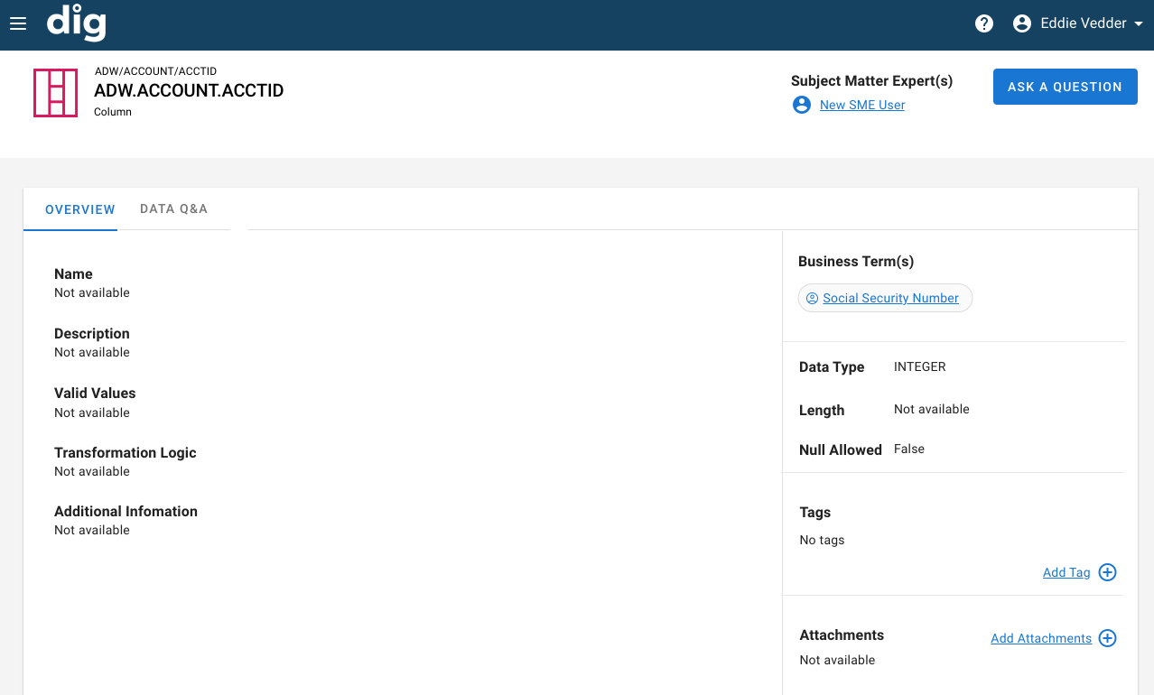
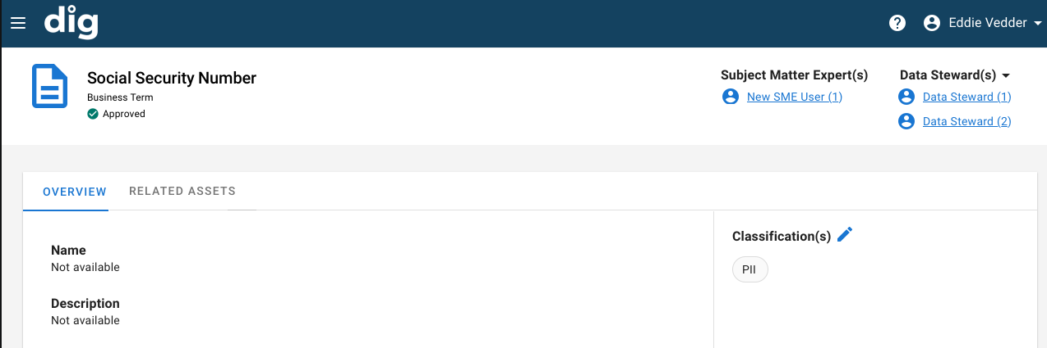
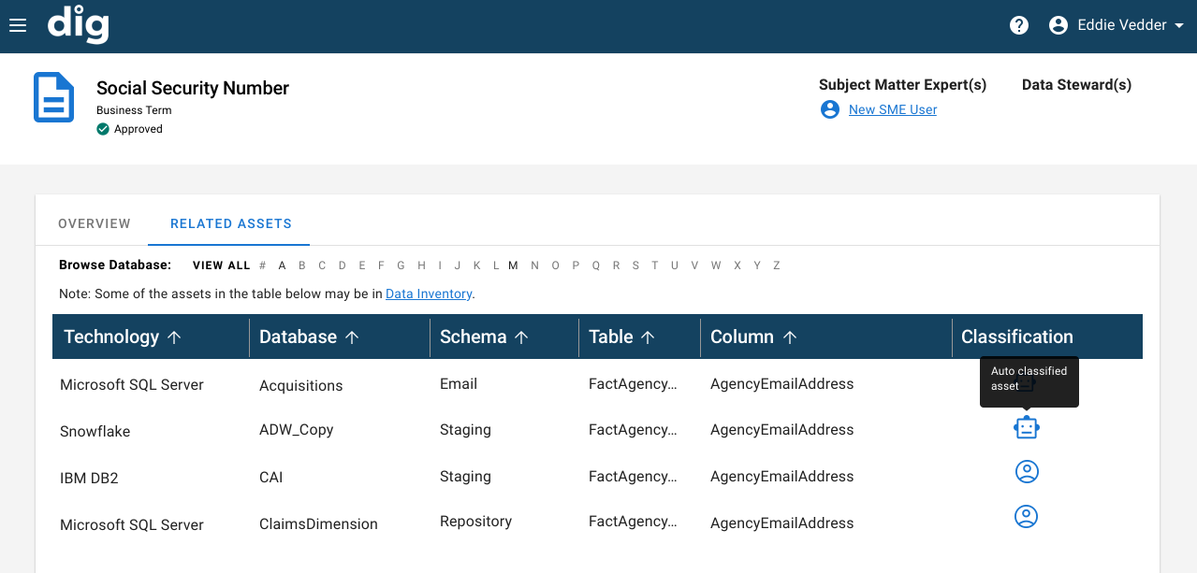
Business Glossary
Notes:
Our initial MVP of Business Glossary is a result of the work you’ve done to be compliant with PI/CHS regulations. The PI and CHS terms defined by our Legal, Data Privacy and Info security teams comprise the initial Business Glossary [click]
and a list of all the physical locations where those assets are found will be displayed as Related Assets within the Glossary, as well as how they were classified. Conversely, [click]
The data dictionaries will be updated to indicate the Business Term tags that have been captured and associated with them.
You’ve already done the work to create this valuable asset – and you’ll be able to reap the benefit of business glossary as we work to comply with some new consumer privacy protections – much of that data is PI and will already have been tagged

Slide 20
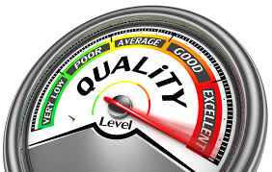
DG Capabilities – Modernized Data Quality Stack
Current Stack | Future Stack
On-Premise $$$ to administer/house hardware and software | Cloud $ to administer subscription-based service
DQ at Rest Measures & metrics performed on target tables after data load | DQ In Motion & at Rest Measures & metrics performed as data is loaded
Reactive DQ Failing values noted after table loads and business rules executed – no active warning of fails & analytics begins with bad data | Proactive DQ Pattern deviations noted at the time of data load – warnings distributed prior to start of analytics
System Monitoring The job failed The server is down | Data Monitoring The file schema has changed The file is same as yesterday The data is ready for analytics/reporting
Manual Profiling Profiling is manually performed on as-needed basis; minimal use cases | Automated Historical Profiling Historical statistics about data quality metrics is automated
Key Benefits:
Decreased cost – Savings realized both in administrative/hardware costs, as well as automated profiling to reduce coding of simple DQ statistics.
Real-Time Monitoring - Awareness of anomalies at the time of data load.
Software Consolidation – Reduction of software tools – selection of best fit for 4 data quality patterns
* Many of today’s DataFlux and Infogix jobs standardize, cleanse, enrich and/or remediate data prior to or rather than providing metrics, measures or balances

Slide 21
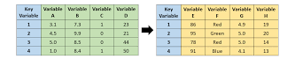
DG Capabilities – Reference Data Management
Key Benefits & Usage:
Increased Accuracy and Consistency - By centralizing reference data in one place, you can ensure that it is always up to date and consistent and/or cross-referenced across all applications. This eliminates the risk of inconsistency caused by different departments using different versions of the same data.
Improved Decision-Making - Reference data is an essential input into most business decisions, so having a reliable system for managing it makes it easier to make informed choices quickly and efficiently. With accurate and up-to-date reference data at your fingertips, you can avoid delays caused by having to track down information from multiple sources.
Reduced IT/Analytic Costs - A well-designed RDM system can automate many routine tasks related to managing reference data, such as cleansing, standardizing, and consolidating data sets. This reduces the workload on IT/Analytics staff and allows them to focus on more strategic projects.
Fewer Data Quality Issues - When reference data is inaccurate, unstandardized or out of date, it can lead to confusion and costly mistakes.
Reference Data Management creates an enterprise-wide cross-reference solution of source code values/descriptions, standardized code values/descriptions, and aggregations or segmentations of the individual values.
Example:
Source | Code | Description | E-RDM Code | E-RDM Description | E-RDM Product Aggreg. | E-RDM BU
M20 | AA | Aligned Auto | AU | Automobile | Personal Vehicle | PL
DCA | AU | Automobile | AU | Automobile | Personal Vehicle | PL
M20 | MC | Regular Motorcycle | MC | Motorcycle | Personal Vehicle | PL
DCA | MC | Motorcycle | MC | Motorcycle | Personal Vehicle | PL
Code Inventory – each source system would provide the code value pairs for governed reference data
Standardization – business/IT representatives collaborate to create common enterprise codes, as well as how each code is aggregated, segmented, etc. for various use cases

Slide 22
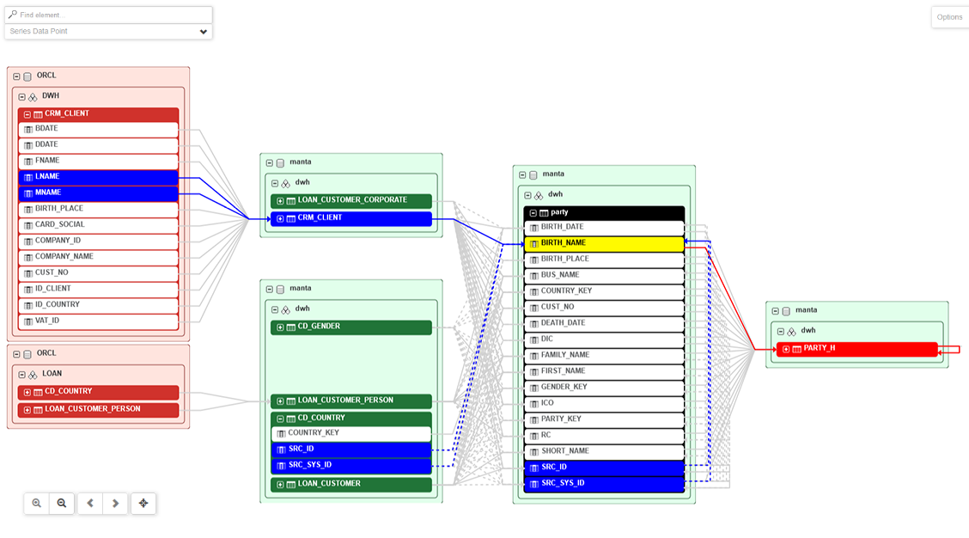
DG Capabilities - Lineage
Data Lineage
Foundational capability for data discovery and consistency
Provides end-to-end movement, transformation and usage of data
Enables the ability to visualize the source of a particular data point
Illustrates potential impact points for data changes/updates
Highlights where CHS and other sensitive data has traversed

